Slide 1




SMART INDIA HACKATHON 2026
TITLE PAGE
  Problem Statement ID – SIH26172
  Problem Statement Title - Low Latency and Efficient Voice Activator for Edge Devices
  Theme - Smart Automation
  PS Category - Hardware
  Team ID -
  Team Name - Electronauts

Slide 2
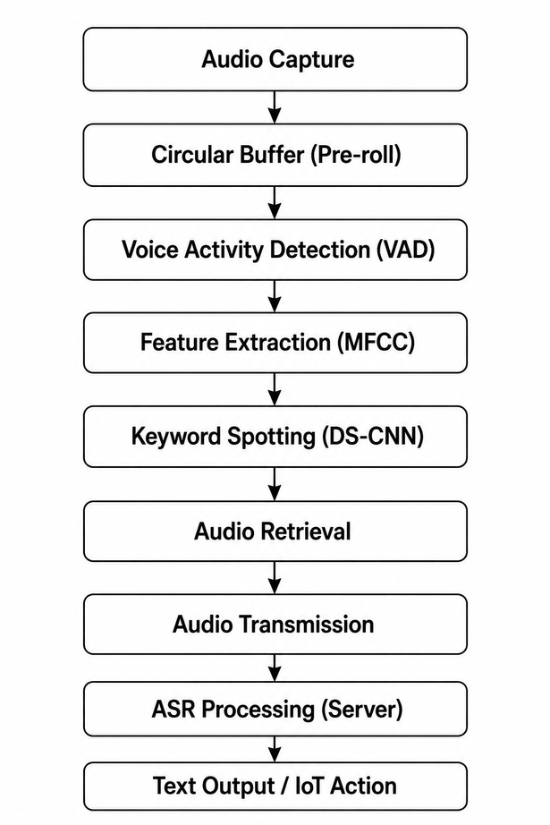
IDEA TITLE
Electronauts
Problem :
  Cloud-based voice processing causes latency, high network usage and privacy concerns.
  Continuous audio streaming increases dependency on the internet.
  Low-power edge devices have limited RAM and CPU resources.
Idea :
  The micropone stays continuously active and listens locally.
  ESP32 detects the custom wake word on-device without continuously sending audio to the cloud.
Impact and innovation :
  Local decision-making: Wake-word detection happens directly on ESP32.
  Zero audio clipping: Circular buffer preserves audio before the wake word.
  Low resource usage: Designed for <256 KB RAM and <10% idle CPU.
  Low network usage: Audio is streamed only after wake-word detection.
  Privacy-focused: Continuous raw audio is not sent to the cloud.
  Custom keyword + open-source TinyML: No proprietary wake-word SDKs or generic pre-trained wake words.
Proposed solution :
  DMA + Circular Buffer continuously captures audio without overloading the CPU.
  VAD detects human speech and activates the KWS model.
  INT8 DS-CNN detects the custom keyword locally.
  After detection, the stored pre-roll + live audio is sent to the ASR server.
  Vosk / Faster-Whisper converts the command into text for IoT action.
@SIH Idea submission- Template
2
Notes:
2

Slide 3
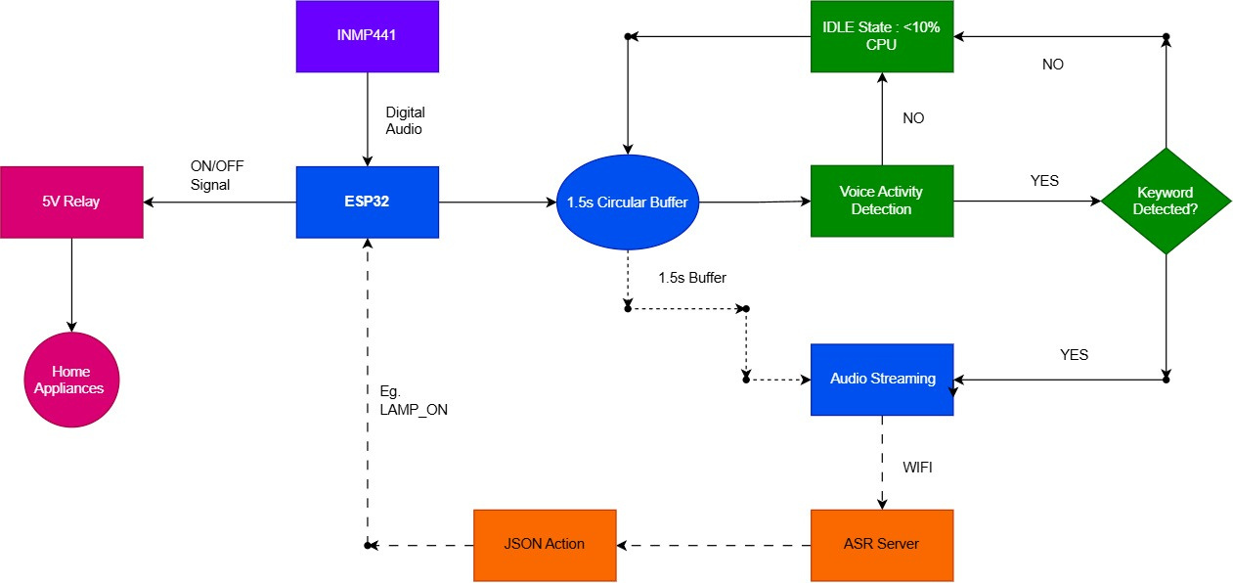
TECHNICAL APPROACH
Electronauts
Hardware :
  ESP32 : Edge Processing Unit. Chosen for its dual-core processing and hardware DMA, perfect for handling parallel audio and network tasks.
  INMP441 : An I2S sensor that pipes digital audio directly into memory, completely bypassing CPU-heavy analog-to-digital conversions.
  5V Relay Module: Chosen to safely toggle physical high-voltage smart home appliances using the ESP32.
AI Stack :
  TensorFlow Lite : An open-source runtime chosen to run our heavily compressed (INT8 quantized) model in a tiny 60–80KB footprint.
  DS-CNN : Model Architecture. Chosen for its ultra-lightweight efficiency, providing highly accurate Keyword Spotting (KWS) while keeping idle CPU utilization strictly < 10%.
  C-Based Ring Buffer: Memory Management. Chosen to constantly hold 1.5 seconds of historical audio in RAM, so the command is never cut off.
Server-Side :
  Google Colab Server: Scalable cloud backend, instantly processing incoming audio streams and returning actionable JSON commands directly to the ESP32.
  Faster-Whisper : An open-source speech recognition engine hosted on Colab, leveraging cloud GPUs for real-time, highly accurate transcription.
@SIH Idea submission- Template
3
Notes:
3

Slide 4
FEASIBILITY AND VIABILITY
Electronauts
Feasibility & Viability :
  ESP32-based: Supports dual-core processing, Wi-Fi and hardware DMA.
  Memory feasible: Ring Buffer (~48 KB) + INT8 model (~70 KB) + TFLM Arena (~40 KB) ≈ 158 KB, within the <256 KB limit.
  Low CPU usage: VAD keeps the system below the <10% idle CPU target.
  Open-source & low-cost: Uses ESP-IDF, TFLM and open-source ASR tools.
  Deployable: ASR can run on a local laptop/server.
Potential Challenges & Risks :
  Background noise → False wake-ups.
  Dataset quality → Reduced keyword accuracy.
  Active processing → Temporary CPU spikes during MFCC/CNN computation.
  Wi-Fi congestion → Packet loss and network jitter.
  Microphone variations → Different accuracy across low-cost microphone modules.
Strategies to Overcome
  Noise: Train with diverse background-noise samples + use VAD.
  Accuracy: Collect recordings from different speakers, accents and environments.
  CPU/Memory: Use INT8 DS-CNN and run AI only after VAD detects speech.
  Network: Use lightweight WebSocket + Wi-Fi reconnection handling.
  Hardware: Test and benchmark with different microphone modules.
@SIH Idea submission- Template
4
Notes:
4

Slide 5
IMPACT AND BENEFITS
Electronauts
Target Audience :
  Smart-Home Users – faster and responsive voice-controlled devices.
  IoT Developers & Engineers – lightweight voice activation for resource-limited devices.
  Businesses & Industries – voice-controlled IoT for automation and monitoring.
Economic Benefits :
  Lower Development Cost — Built on open-source frameworks, avoiding proprietary SDK fees.
  Reduced Data Cost — Audio streams only after wake-word detection, cutting unnecessary data usage.
Overall Impact :
  Triggered Streaming – Data is transmitted only when needed, reducing data usage, cost, and energy consumption.
  Privacy by Design – No raw audio leaves the device, ensuring user data remains private.
  SDK Independent – No proprietary SDKs; low-cost edge hardware performs the required processing locally.
Social Benefits :
  Better User Experience — On-device wake-word detection means faster response and smoother interaction.
  Improved Privacy — Audio stays local; no continuous raw audio is sent to the cloud.
Environmental Benefits :
  Low Power Consumption — Lightweight on-device AI models draw minimal power.
  Reduced Data Transmission — Less continuous streaming lowers network and energy usage.
@SIH Idea submission- Template
5
Notes:
5

Slide 6
RESEARCH AND REFERENCES
Electronauts
  Research areas: edge AI, keyword spotting, TinyML, low-latency streaming, IoT voice control.
  Supporting references: IEEE papers, Article on ESP32 TinyML implementation, and Google Scholar sources on keyword spotting and TensorFlow Lite Micro.
  Research Paper and Reports : https://drive.google.com/drive/folders/1GnupSJw4ptxABWDBkI7cEEF0qOaIb0ff?usp=drive_link
  Demo Video : https://drive.google.com/drive/folders/1hQZrd8yofaLOQsUQouFpJ11uPzKuLRpo?usp=drive_link
  Further References : https://drive.google.com/drive/folders/1W00cczZe7VaKeJny0QiycFpMyPxm-vsg?usp=drive_link
@SIH Idea submission- Template
6
Notes:
6

